Slide 1
An introduction to OpenMP

Slide 2
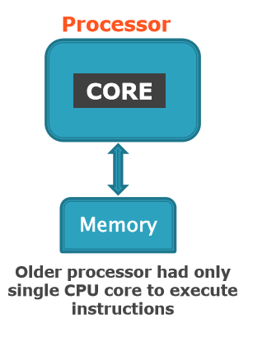
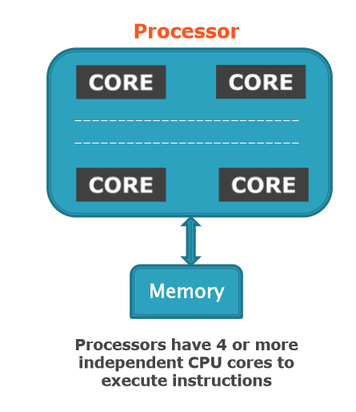
Basic Architecture

Slide 3
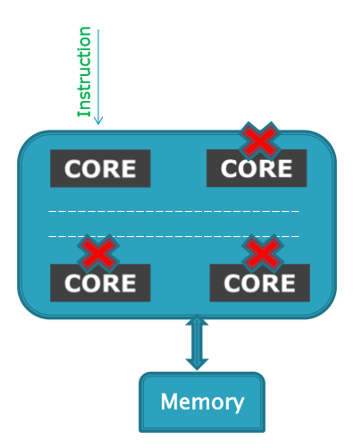
Sequential Program Execution
When you run sequential
program
Instructions executed in serial
Other cores are idle
Waste of available resource...
We want all cores to be used
to execute program.
HOW ?

Slide 4
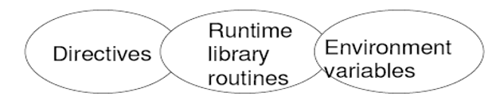
OpenMP Introduction
Open Specification for Multi Processing.
It is an specification for
OpenMP is an Application Program Interface
(API) for writing multi-threaded, shared
memory parallelism.
Easy to create multi-threaded programs in
C,C++ and Fortran.

Slide 5
Why Choose OpenMP ?
Portable
  standardized for shared memory architectures
Simple and Quick
  Relatively easy to do parallelization for small parts of
an application at a time
  Incremental parallelization
  Supports both fine grained and coarse grained
parallelism
Compact API
  Simple and limited set of directives
  Not automatic parallelization

Slide 6
Execution Model
OpenMP program starts single threaded
To create additional threads, user starts a parallel region
  additional threads are launched to create a team
  original (master) thread is part of the team
  threads “go away” at the end of the parallel region:
usually sleep or spin
Repeat parallel regions as necessary
Fork-join model

Slide 7
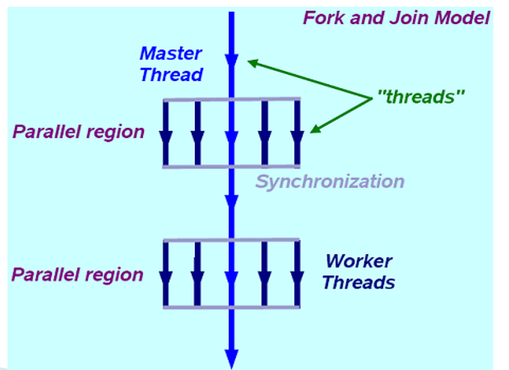
OpenMP Programming Model
main (..)
{
#pragma omp parallel
{
……
…...
}
#pragma omp parallel
{
……
…...
}
}

Slide 8
OpenMP
Language extension for C/C++
Uses #pragma feature
  Pre-processor directive
  Ignored if the compiler doesn’t understand
Using OpenMP
  #include <omp.h>
gcc –fopenmp program.c

Slide 9
Communication Between Threads
Shared Memory Model
  threads read and write shared variable no need for explicit message passing
  use synchronization to protect against race conditions
  change storage attributes for minimizing synchronization and improving cache reuse

Slide 10
When to use openMP ?
Target platform is multi core or
multiprocessor.
Application is cross-platform
Parallelizable loop
Last-minute optimization

Slide 11
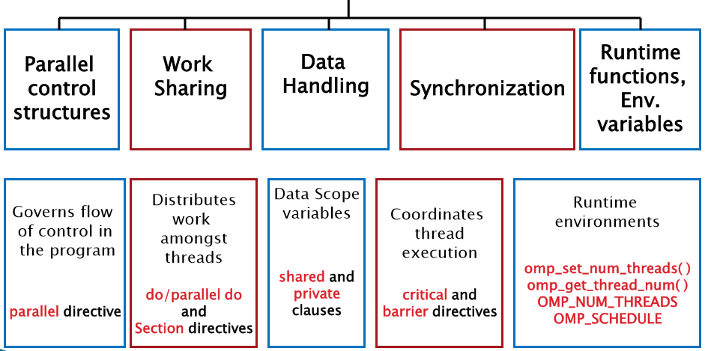
OpenMP Language extensions

Slide 12
OpenMP Constructs
Parallel Regions
#pragma omp parallel
Worksharing
#pragma omp for, #pragma omp sections
Data Environment
#pragma omp parallel shared/private (...)
Synchronization
#pragma omp barrier, #pragma omp critical

Slide 13
OpenMP API Example
Sequential code:
  statement1;
  statement2;
  statement3;
Assume we want to execute statement 2 in parallel, and statement 1 and 3 sequentially.

Slide 14
OpenMP API Example (2 of 2)
OpenMP parallel code:
  statement 1;
  #pragma <specific OpenMP directive>
  statement2;
  statement3;
Statement 2 (may be) executed in parallel.
Statement 1 and 3 are executed sequentially.

Slide 15
Important Note
By giving a parallel directive, the user asserts that the program will remain correct if the statement is executed in parallel.
OpenMP compiler does not check correctness.
Some tools exist for helping with that.
Totalview - good parallel debugger

Slide 16
General Rules about Directives
They always apply to the next statement, which must be a structured block.
Examples
  #pragma omp …
  statement
  #pragma omp …
  { statement1; statement2; statement3; }

Slide 17
OpenMP Parallel Region
  #pragma omp parallel
A number of threads are spawned at entry.
Each thread executes the same code.
Each thread waits at the end.
Very similar to a number of create/join’s with the same function in Pthreads.

Slide 18
Thread Identification
  int omp_get_thread_num()
  int omp_get_num_threads()
Gets the thread id.
Gets the total number of threads.

Slide 19
Example
  #pragma omp parallel
  {
  if( !omp_get_thread_num() )
  master();
  else
  worker();
  }

Slide 20
Threading Model
int x = 5;
#pragma omp parallel
{
x++;
}
The same thing is done by all threads
All data is shared between all threads

Slide 21
Threading Model
int x = 5;
#pragma omp parallel
{
x++;
}
The same thing is done by all threads
All data is shared between all threads
Value of x at end of loop depends on…
  Number of threads
  Which order they execute in
This code is non-deterministic and will produce different results on different runs

Slide 22
Threading Model
We rarely want all the threads to do exactly the same thing
Usually want to divide up work between threads
Three basic constructs for dividing work
  Parallel for
  Parallel sections
  Parallel task

Slide 23
Threading Model
Some constructs for dividing work
  Parallel for
  Parallel sections
  Parallel task
Additional constructs
  Master thread
  Single thread

Slide 24
Parallel For
Divides the iterations of a for loop between the threads
#pragma omp parallel for
for (i = 0; i < n; i++ ) {
a[i] = b[i] * c[i];
}
All variables shared
Except loop control variable

Slide 25
Conditions for parallel for
Several restrictions on for loops that can be threaded
The loop variable must be of type integer.
The loop condition must be of the form:
i <, <=, > or >= loop_invariant_integer
A loop invariant integer is an integer expression whose value doesn’t change throughout the running of the loop
The third part of the for loop must be either an integer addition or an integer subtraction of the loop variable by a loop invariant value
If the comparison operator is < or <= the loop variable should be added to on every iteration, and the opposite for > and >=
The loop must be a single entry and single exit loop, with no jumps from the inside out or from the outside in.
The main meaning of these restrictions are that the number of iterations of the loop must be knows at the loop entry, and it must be easy for OpenMP to figure out the number of iterations

Slide 26
Parallel for
The iterations of the for loop are divided among the threads
Implicit barrier at the end of the for loop
  All threads must wait until all iterations of the for loop have completed

Slide 27
Parallel sections
Parallel for divides the work of a for loop among threads
  All threads do the same for loop, but different iterations
Parallel sections allow different things to be done by different threads
  Allow unrelated but independent tasks to be done in parallel.

Slide 28
Parallel sections
#pragma omp parallel sections
{
#pragma omp section
{
min = find_min(a);
}
#pragma omp section
{
max = find_max(a);
}
}

Slide 29
Parallel sections
Parallel sections can be used to express independent tasks that are difficult to express with parallel for
Number of parallel sections is fixed in the code
  Although the number of threads depends on the machine the program is running on

Slide 30
Parallel task
Need constructs to deal with
  Loops where number of iterations is not known
  Recursive algorithms
Tasks are parallel jobs that can be done in any order
  They are added to a pool of tasks and executed when the system is ready

Slide 31
Parallel task
#pragma omp parallel
{
#pragma omp single // just one thread does this bit
{
#pragma omp task
{
printf(“Hello “);
}
#pragma omp task
{
printf(“world ”);
}
}
}

Slide 32
Parallel task
Creates a pool of work to be done
Pool is initially empty
A task is added to the pool each time we enter a “task” pragma
The threads remove work from the queue and execute the tasks
The queue is disbanded when…
  All enqueued work is complete
  And…
    End of parallel region or
    Explicit #pragma omp taskwait

Slide 33
Parallel task
Tasks are very flexible
  Can be used for all sorts of problems that don’t fit well into parallel for and parallel sections
  Don’t need to know how many tasks there will be at the time we enter the loop
But there is an overhead of managing the pool
Order of execution not guaranteed
  Tasks are taken from pool in arbitrary order whenever a thread is free
But it is possible for one task to create another
  Allows a partial ordering of tasks
  If task A creates task B, then we are guaranteed that task B starts after task A

Slide 34
Task example: Linked List
p = list_head;
#pragma omp parallel
{
#pragma omp single
{
while ( p != NULL) {
#pragma omp task firstprivate(p)
{
do_some_work(p);
}
p = p->next;
}
}
}

Slide 35
Mixing constructs
#pragma omp parallel {
/* all threads do the same thing here */
#pragma omp for
for ( i = 0; i < n; i++ ) {
/*loop iterations divided between threads*/
}
/* there is an implicit barrier here that makes all threads wait until all are finished */
#pragma omp sections
{
#pragma omp section
{
/* executes in parallel with code from other section */
}
#pragma omp section
{
/* executes in parallel with code from other section */
}
}
/* there is an implicit barrier here that makes all threads wait until all are finished */
/* all threads do the same thing again */
}

Slide 36
Private variables
By default all variables are shared
But private variables can also be created
Some variables are private by default
  Variables declared within the parallel block
  Local variables of function called from within the parallel block
  The loop control variable in parallel for

Slide 37
Private variables
/* compute sum of array of ints */
int sum = 0;
#pragma omp parallel for
for ( i = 0; i < n; i++ ) {
#pragma omp critical
sum += a[i];
}
Code works but is inefficient, because of contention between threads caused by the atomic update

Slide 38
Private variables
#include <stdio.h>
#include <omp.h>
int main (void)
{
int i = 10;
omp_set_num_threads(3);
#pragma omp parallel private(i)
{
printf("thread %d: i = %d\n", omp_get_thread_num(), i);
i = 1000 + omp_get_thread_num();
}
printf("i = %d\n", i);
return 0;
}

Slide 39
private Clause
The values of private data are undefined upon
entry to and exit from the specific construct.
Loop iteration variable is private by default.

Slide 40
Private variables
/* compute sum of array of ints */
int sum = 0;
#pragma omp parallel
{
int local_sum = 0;
#pragma omp for
for ( i = 0; i < n; i++ ) {
local_sum += a[i];
}
#pragma omp critical
sum += local_sum;
}

Slide 41
Private variables
/* compute sum of array of ints */
int sum = 0;
int local_sum;
#pragma omp parallel private(local_sum)
{
local_sum = 0;
#pragma omp for
for ( i = 0; i < n; i++ ) {
local_sum += a[i];
}
#pragma omp critical
sum += local_sum;
}
This time, each thread still has its own copy of local_sum, but another variable of the same name also exists outside the parallel region

Slide 42
Private variables
Strange semantics with private variables
  Declaring variable private creates new variable that is local to each thread
  No connection between this local variable and the other variable outside
    It’s almost like creating a new local variable within a C/C++ block (that is a piece of code between a pair of matching curly brackets)
  Local variable is given default value
    Usually zero
  Value of “outside” version of the private variable is undefined after parallel region (!)
    So it’s not exactly like declaring a new local variable within a C/C++ block

Slide 43
firstprivate
We often want a private variable that starts with the value of the same variable outside the parallel region
The firstprivate construct allows us to do this
/* compute sum of array of ints */
int sum = 0;
int local_sum = 0;
#pragma omp parallel firstprivate(local_sum)
{
/* local_sum in here is initialised with local sum value from outside */
#pragma omp for
for ( i = 0; i < n; i++ ) {
local_sum += a[i];
}
#pragma omp critical
sum += local_sum;
}

Slide 44
firstprivate Clause
The clause combines behavior of private
clause with automatic initialization of the
variables in its list.
Example:
b=50,n=1858;
printf(“Before parallel loop: b=%d ,n=%d\n”,b,n)
#pragma omp parallel for private(i), firstprivate(b), lastprivate(a)
for(i=0; i<n; i++)
{
a=i+b;
}
c=a+b;

Slide 45
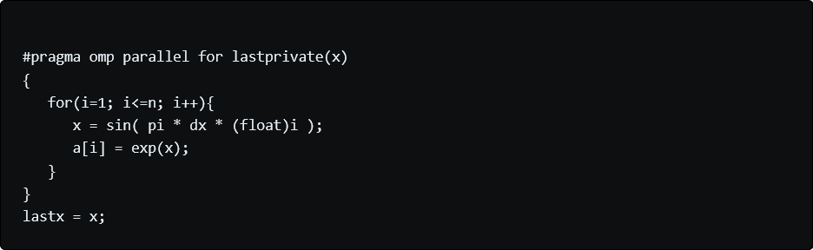
lastprivate Clause
lastprivate clause is used for:
thread that executes the ending loop index copies its value to the master (serial) thread
this gives the same result as serial execution

Slide 46
lastprivate Clause
Performs finalization of private variables.
Each thread has its own copy.
Example:
b=50,n=1858;
printf(“Before parallel loop: b=%d ,n=%d\n”,b,n)
#pragma omp parallel for private(i), firstprivate(b), lastprivate(a)
for(i=0; i<n; i++)
{
a=i+b;
}
c=a+b;

Slide 47
Private variables and tasks
p = list_head;
#pragma omp parallel
{
#pragma omp single
{
while ( p != NULL) {
#pragma omp task // this code is broken!!!
{
do_some_work(p);
}
p = p->next;
}
}
}
Problem that the value is p may change between the time that the task is created and the time that the task starts to execute
The task needs its own private copy of p

Slide 48
Private variables and tasks
p = list_head;
#pragma omp parallel
{
#pragma omp single
{
while ( p != NULL) {
#pragma omp task firstprivate(p) // this code works…
{ do_some_work(p);
}
p = p->next;
}
}
}
Firstprivate declaration creates a new copy of p within the task
Has value of original p at the point where the task was created

Slide 49
Shared variables
By default all variables in a parallel region are shared
Can also explicitly declare them to be shared
Can opt to force all variables to be declared shared or non-shared
Use “default(none)” declaration to specify this

Slide 50
Shared variables
/* example of requiring all variables be declared shared or non-shared */
#pragma omp parallel default(none) \ shared(n,x,y) private(i)
{
#pragma omp for
for (i=0; i<n; i++)
x[i] += y[i];
}

Slide 51
schedule clause
Describe how iterations of the loop are divided among the threads in the group.

Slide 52
Scheduling parallel for loops
Usually with parallel for loops, the amount of work in each iteration is roughly the same
  Therefore iterations of the loop are divided approximately evenly between threads
Sometimes the work in each iteration can vary significantly
  Some iterations take much more time
  => Some threads take much more time
  Remaining threads are idle
This is known as poor “load balancing”

Slide 53
Scheduling parallel for loops
OpenMP provides four “scheduling” options
static
  Iterations are divided evenly between the threads (this is the default)
  We can also specify a chunk size for the amount of work given out at a time
dynamic
  Iterations are put onto a work queue, and threads take iterations from the queue whenever they become idle. You can specify a “chunk size”, so that iterations are taken from the queue in chunks by the threads, rather than one at a time
guided
  Similar to dynamic, but initially the chunk size is large, and as the loop progresses the chunk size becomes smaller
  allows finer grain load balancing toward the end
auto
  The compiler (or OpenMP runtime system) decides which strategy to use

Slide 54
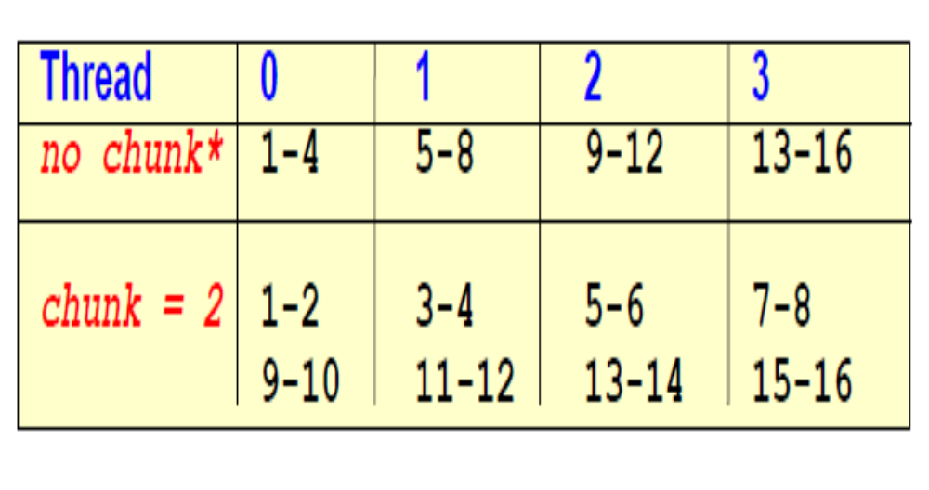
Static scheduling
16 iterations, 4 threads:

Slide 55
Static scheduling
int main()
{
omp_set_num_threads(4);
#pragma omp parallel for schedule(static, 3)
for (int i = 0; i < 20; i++)
{ printf("Thread %d is running number %d\n", omp_get_thread_num(), i);
}
return 0; }

Slide 56
Dynamic
OpenMP will still split task into iter_size/chunk_size chunks,
but distribute trunks to threads dynamically without any specific order.
int main()
{ #pragma omp parallel for schedule(dynamic, 1) for (int i = 0; i < 20; i++)
{ printf("Thread %d is running number %d\n", omp_get_thread_num(), i);
} return 0;
}

Slide 57
Guided
int main()
{ omp_set_num_threads(4);
#pragma omp parallel for schedule(guided, 3)
for (int i = 0; i < 20; i++)
{ printf("Thread %d is running number %d\n", omp_get_thread_num(), i);
} return 0;
}

